Slide 1
Chapter 3: Formal Relational Query Languages

Slide 2
Chapter 3: Formal Relational Query Languages
Relational Algebra: quan hệ đại số
Tuple Relational Calculus :
Domain Relational Calculus

Slide 3
Relational Algebra
Procedural language
Six basic operators
  select: σ
  project: ∏
  union: ∪
  set difference: –
  Cartesian product: x
  rename: ρ
The operators take one or two relations as inputs and produce a new relation as a result.
(“mất một hoặc hai quan hệ như là đầu vào và tạo ra một mối quan hệ mới là một kết quả.”)

Slide 4

Select Operation – Example
Relation r
σ_{A=B ^ D > 5} (r)

Slide 5
Select Operation
Notation: σ _{p}(r)
p is called the selection predicate
Defined as:
σ_{p}(r) = {t | t ∈ r and p(t)}
Where p is a formula in propositional calculus consisting of terms connected by : ∧ (and), ∨ (or), ¬ (not)
“Trong đó p là một công thức trong tính toán mệnh đề bao gồm các điều khoản kết nối”
Each term is one of:
<attribute> op <attribute> or <constant>
“attribute:đặc tính,”
where op is one of: =, ≠, >, ≥. <. ≤
Example of selection:
σ _{dept_name=“Physics”}(instructor)

Slide 6

Project Operation – Example
Relation r:
∏_{A,C} (r)

Slide 7

Project Operation
Notation:
where A₁, A₂ are attribute names and r is a relation name.
The result is defined as the relation of k columns obtained by erasing the columns that are not listed
“Kết quả này được xác định mối quan hệ của cột k thu được bằng cách xóa các cột mà không được liệt kê”
Duplicate rows removed from result, since relations are sets
“bản sao hàng loại bỏ giá trị,kể từ khi qh là các tập”
Example: given instructor(ID, name, dept_name, salary) To eliminate the dept_name attribute of instructor.
∏_{ID, name, salary} (instructor)

Slide 8

Union Operation – Example
Relations r, s:
r ∪ s:

Slide 9
Union Operation
Notation: r ∪ s
Defined as:
r ∪ s = {t | t ∈ r or t ∈ s}
For r ∪ s to be valid.
1. r, s must have the same arity (same number of attributes)
2. The attribute domains must be compatible (example: 2nd column of r deals with the same type of values as does the 2nd
column of s)
Example: to find all courses taught in the Fall 2009 semester, or in the Spring 2010 semester, or in both
∏_{course_id} (σ _{semester=“Fall” Λ year=2009} (section)) ∪
∏_{course_id} (σ _{semester=“Spring” Λ year=2010} (section))

Slide 10

Set difference of two relations
Relations r, s:
r – s:

Slide 11
Set Difference Operation
Notation r – s
Defined as:
r – s = {t | t ∈ r and t ∉ s}
Set differences must be taken between compatible relations.
  r and s must have the same arity
  attribute domains of r and s must be compatible
Example: to find all courses taught in the Fall 2009 semester, but not in the Spring 2010 semester
∏_{course_id} (σ _{semester=“Fall” Λ year=2009} (section)) −
∏_{course_id} (σ _{semester=“Spring” Λ year=2010} (section))

Slide 12

Cartesian-Product Operation – Example
Relations r, s:
r x s:

Slide 13
Cartesian-Product Operation
Notation r x s
Defined as:
r x s = {t q | t ∈ r and q ∈ s}
Assume that attributes of r(R) and s(S) are disjoint. (That is, R ∩ S = ∅).
If attributes of r(R) and s(S) are not disjoint, then renaming must be used.

Slide 14

Composition of Operations
Can build expressions using multiple operations
Example: σ_{A=C}(r x s)
r x s
σ_{A=C}(r x s)

Slide 15

Rename Operation
Allows us to name, and therefore to refer to, the results of relational-algebra expressions.
Allows us to refer to a relation by more than one name.
Example:
ρ _{x} (E)
returns the expression E under the name X
If a relational-algebra expression E has arity n, then
returns the result of expression E under the name X, and with the
attributes renamed to A₁ , A₂ , …., A_{n} .

Slide 16
Example Query
given instructor(ID, name, dept_name, salary). Find the largest salary in the university
  Step 1: find instructor salaries that are less than some other instructor salary (i.e. not maximum)
      using a copy of instructor under a new name d
    ∏_{instructor.salary} (σ _{instructor.salary < d,salary} (instructor x ρ_{d} (instructor)))
  Step 2: Find the largest salary
    ∏_{salary} (instructor) –
    ∏_{instructor.salary} (σ _{instructor.salary < d,salary} (instructor x ρ_{d} (instructor)))

Slide 17
Example Queries
Given instructor(ID, name, dept_name, salary) and
teaches(ID, courseID, sec_ID, semester, year)
Find the names of all instructors in the Physics department, along with the course_id of all courses they have taught
  Query 1
  ∏_{instructor.ID,course_id} (σ_{dept_name=“Physics”} (
  σ _{instructor.ID=teaches.ID} (instructor x teaches)))
  Query 2
  ∏_{instructor.ID,course_id} (σ_{instructor.ID=teaches.ID} (
  σ _{dept_name=“Physics”} (instructor) x teaches))

Slide 18
Formal Definition
A basic expression in the relational algebra consists of either one of the following:
  A relation in the database
  A constant relation
Let E₁ and E₂ be relational-algebra expressions; the following are all relational-algebra expressions:
  E₁ ∪ E₂
  E₁ – E₂
  E₁ x E₂
  σ_{p} (E₁), P is a predicate on attributes in E₁
  ∏_{s}(E₁), S is a list consisting of some of the attributes in E₁
  ρ _{x} (E₁), x is the new name for the result of E₁

Slide 19
Additional Operations
We define additional operations that do not add any power to the
relational algebra, but that simplify common queries.
Set intersection
Natural join
Assignment
Outer join

Slide 20
Set-Intersection Operation
Notation: r ∩ s
Defined as:
r ∩ s = { t | t ∈ r and t ∈ s }
Assume:
  r, s have the same arity
  attributes of r and s are compatible
Note: r ∩ s = r – (r – s)
(Phép Giao)

Slide 21

Set-Intersection Operation – Example
Relation r, s:
r ∩ s

Slide 22
Natural-Join Operation
Notation: r s
Let r and s be relations on schemas R and S respectively.
Then, r s is a relation on schema R ∪ S obtained as follows:
  Consider each pair of tuples t_{r} from r and t_{s} from s.
  If t_{r} and t_{s} have the same value on each of the attributes in R ∩ S, add a tuple t to the result, where
    t has the same value as t_{r} on r
    t has the same value as t_{s} on s
Example:
  R = (A, B, C, D)
  S = (E, B, D)
  Result schema = (A, B, C, D, E)
  r s is defined as:
  ∏_{r.A, r.B, r.C, r.D, s.E} (σ_{r.B = s.B ∧ r.D = s.D} (r x s))

Slide 23

Natural Join Example
Relations r, s:
r s

Slide 24
Natural Join and Theta Join
Find the names of all instructors in the Comp. Sci. department together with the course titles of all the courses that the instructors teach
  ∏ _{name, title} (σ _{dept_name=“Comp. Sci.”} (instructor teaches course))
Natural join is associative
  (instructor teaches) course is equivalent to
  instructor (teaches course)
Natural join is commutative
  instruct teaches is equivalent to
  teaches instructor
The theta join operation r _{θ} s is defined as
  r _{θ} s = σ_{θ} (r x s)
Notes:
Commutative tính giao hoán

Slide 25
Assignment Operation
The assignment operation (←) provides a convenient way to express complex queries.
  Write query as a sequential program consisting of
    a series of assignments
    followed by an expression whose value is displayed as a result of the query.
  Assignment must always be made to a temporary relation variable.

Slide 26
Outer Join
An extension of the join operation that avoids loss of information.
Computes the join and then adds tuples form one relation that does not match tuples in the other relation to the result of the join.
Uses null values:
  null signifies that the value is unknown or does not exist

Slide 27
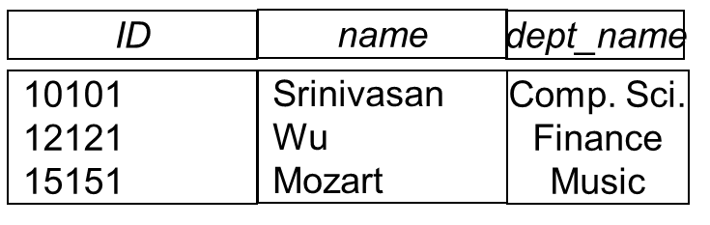
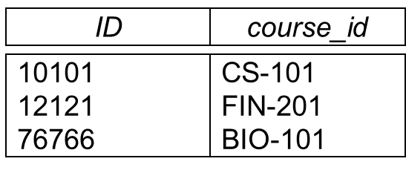
Outer Join – Example
Relation instructor1
Relation teaches1

Slide 28
Outer Join – Example
Join (inner join)
instructor teaches
ID
name
dept_name
course_id
10101
12121
Srinivasan
Wu
Comp. Sci.
Finance
CS-101
FIN-201
Left Outer Join
instructor teaches
ID
name
dept_name
course_id
10101
12121
15151
Srinivasan
Wu
Mozart
Comp. Sci.
Finance
Music
CS-101
FIN-201
null

Slide 29
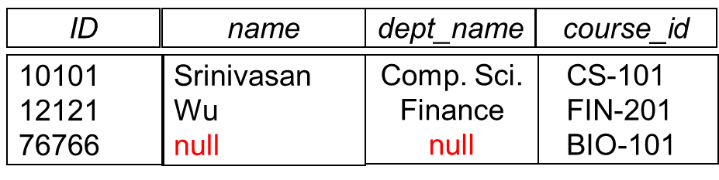
Outer Join – Example
Right Outer Join
instructor teaches
Full Outer Join
instructor teaches
ID
name
dept_name
course_id
10101
12121
15151
76766
Srinivasan
Wu
Mozart
null
Comp. Sci.
Finance
Music
null
CS-101
FIN-201
null
BIO-101

Slide 30
Null Values
It is possible for tuples to have a null value, denoted by null, for some of their attributes.
null signifies an unknown value or that a value does not exist.
The result of any arithmetic expression involving null is null.
Aggregate functions simply ignore null values (as in SQL)
For duplicate elimination and grouping, null is treated like any other value, and two nulls are assumed to be the same (as in SQL)

Slide 31
Division Operator
Given relations r(R) and s(S), such that S ⊂ R, r ÷ s is the largest relation t(R-S) such that
t x s ⊆ r
E.g. let r(ID, course_id) = ∏_{ID, course_id} (takes ) and
s(course_id) = ∏_{course_id} (σ_{dept_name=“Biology”}(course )
then r ÷ s gives us students who have taken all courses in the Biology department
Can write r ÷ s as
temp1 ← ∏_{R-S} (r )
temp2 ← ∏_{R-S} ((temp1 x s ) – ∏_{R-S,S} (r ))
result = temp1 – temp2
  The result to the right of the ← is assigned to the relation variable on the left of the ←.
  May use variable in subsequent expressions.

Slide 32

Schema Diagram for University Database

Slide 33
Extended Relational-Algebra-Operations
Generalized Projection
Aggregate Functions

Slide 34
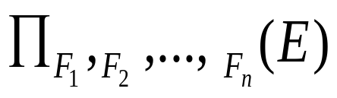
Generalized Projection
Extends the projection operation by allowing arithmetic functions to be used in the projection list.
E is any relational-algebra expression
Each of F₁, F₂, …, F_{n} are arithmetic expressions involving constants and attributes in the schema of E.
Given relation instructor(ID, name, dept_name, salary) where salary is annual salary, get the same information but with monthly salary
∏_{ID, name, dept_name, salary/12} (instructor)

Slide 35


Aggregate Functions and Operations
Aggregation function takes a collection of values and returns a single value as a result.
avg(tính tb), min, max, sum, count(đếm)
Aggregate operation in relational algebra
E is any relational-algebra expression
  G₁, G₂ …, G_{n} is a list of attributes on which to group (can be empty)
  Each F_{i} is an aggregate function
  Each A_{i} is an attribute name
Note: Some books/articles use γ or (Calligraphic G)
: pronounced script F
F
F

Slide 36
Aggregate Operation – Example
Relation r:
A
B
C
α
α
β
β
α
β
β
β
7
7
3
10
F
_{sum(c)} (r)
“không gôm nhóm”
sum(c )
27

Slide 37


Aggregate Operation – Example
Find the average salary in each department
_{dept_name} _{avg(salary)} (instructor)
“gôm nhóm”
F
avg_salary

Slide 38
Aggregate Functions (Cont.)
Result of aggregation does not have a name
  Can use rename operation to give it a name
  For convenience, we permit renaming as part of aggregate operation
  avg_sal: ten cột ms
F
_{dept_name} _{avg(salary) as avg_sal} (instructor)

Slide 39
Modification of the Database
The content of the database may be modified using the following operations:
  Deletion
  Insertion
  Updating
  “tự xử”
All these operations can be expressed using the assignment operator

Slide 40
Given a banking database:
BRANCH(branch name, branch city, assets)
CUSTOMER (customer name, customer street, customer city)
LOAN (loan number, branch name, amount)
BORROWER (customer name, loan number)
ACCOUNT (account number, branch name, balance)
DEPOSITOR (customer name, account number)

Slide 41
Deletion
A delete request is expressed similarly to a query, except instead of displaying tuples to the user, the selected tuples are removed from the database.
Can delete only whole tuples; cannot delete values on only particular attributes
A deletion is expressed in relational algebra by:
r ← r – E
where r is a relation and E is a relational algebra query.

Slide 42
Deletion Examples
Delete all account records in the Perryridge branch.
account ← account – σ _{branch_name = “Perryridge”} (account )
Delete all loan records with amount in the range of 0 to 50
loan ← loan – σ _{amount ≥ 0 and amount ≤ 50} (loan)
Delete all accounts at branches located in Needham.
r₁ ← σ _{branch_city = “Needham”} (account branch )
r₂ ← ∏ _{account_number,} _{branch_name, balance} (r₁)
r₃ ← ∏ _{customer_name, account_number} (r₂ depositor)
account ← account – r₂
depositor ← depositor – r₃

Slide 43
Insertion
To insert data into a relation, we either:
  specify a tuple to be inserted
  write a query whose result is a set of tuples to be inserted
in relational algebra, an insertion is expressed by:
r ← r ∪ E
where r is a relation and E is a relational algebra expression.
The insertion of a single tuple is expressed by letting E be a constant relation containing one tuple.

Slide 44
Insertion Examples
Insert information in the database specifying that Smith has $1200 in account A-973 at the Perryridge branch.
account ← account ∪ {(“A-973”, “Perryridge”, 1200)}
depositor ← depositor ∪ {(“Smith”, “A-973”)}
Provide as a gift for all loan customers in the Perryridge
branch, a $200 savings account. Let the loan number serve
as the account number for the new savings account.
r₁ ← (σ_{branch_name = “Perryridge”} (borrower loan))
account ← account ∪ ∏_{loan_number, branch_name, 200} (r₁)
depositor ← depositor ∪ ∏_{customer_name, loan_number} (r₁)

Slide 45
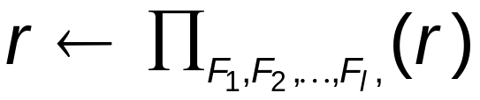
Updating
A mechanism to change a value in a tuple without charging all values in the tuple
Use the generalized projection operator to do this task
Each F_{i} is either
  the i ^{th} attribute of r, if the i ^{th} attribute is not updated, or,
  if the attribute is to be updated F_{i} is an expression, involving only constants and the attributes of r, which gives the new value for the attribute

Slide 46
Update Examples
Make interest payments by increasing all balances by 5 percent.
account ← ∏ account_number, branch_name, balance * 1.05 (account)
Pay all accounts with balances over $10,000 6 percent interest and pay all others 5 percent
account ← ∏ account_number, branch_name, balance * 1.06 (σ _{BAL > 10000} (account ))
∪ ∏ account_number, branch_name, balance * 1.05 (σ_{BAL ≤ 10000} (account))

Slide 47
Example Queries
Find the names of all customers who have a loan and an account at bank.
  ∏_{customer_name} (borrower) ∩ ∏_{customer_name} (depositor)
Find the name of all customers who have a loan at the bank and the loan amount
  ∏customer_name, loan_number, amount (borrower loan)

Slide 48
Example Queries
Find all customers who have an account from at least the “Downtown” and the Uptown” branches.
  Query 1
    ∏_{customer_name} (σ_{branch_name = “Downtown”} (depositor account )) ∩
    ∏_{customer_name} (σ_{branch_name = “Uptown”} (depositor account))
  Query 2
  ∏_{customer_name, branch_name} (depositor account)
  ÷ ρ_{temp(branch_name)} ({(“Downtown” ), (“Uptown” )})
  Note that Query 2 uses a constant relation.

Slide 49
Bank Example Queries
Find all customers who have an account at all branches located in Brooklyn city.
∏_{customer_name, branch_name} (depositor account)
÷ ∏_{branch_name} (σ_{branch_city = “Brooklyn”} (branch))

Slide 50
End of Chapter 6

Slide 51
Multiset Relational Algebra
Pure relational algebra removes all duplicates
  e.g. after projection
Multiset relational algebra retains duplicates, to match SQL semantics
  SQL duplicate retention was initially for efficiency, but is now a feature
Multiset relational algebra defined as follows
  selection: has as many duplicates of a tuple as in the input, if the tuple satisfies the selection
  projection: one tuple per input tuple, even if it is a duplicate
  cross product: If there are m copies of t1 in r, and n copies of t2 in s, there are m x n copies of t1.t2 in r x s
  Other operators similarly defined
    E.g. union: m + n copies, intersection: min(m, n) copies
    difference: min(0, m – n) copies

